Slide 1

MALLA REDDY ENGINEERING COLLEGE (AUTONOMOUS)
HOSTILE INTENTION DETECTION
submited by
16j41a05c8- mithilesh
16j41a05h9- satya kumar
16j41a05e5- uday kumar
16j41a05d3- nag kamal
17j45a0505- rakesh
under the guidence of head of dept(CSE)
DR. S. Dhanalakshmi Dr. G Charles babu
professor professor
1

Slide 2
Table of contents
1.Abstract
2.Existing system
3.Proposed system
4.Why python
5.Libraries used
6.System requirements
7.Convolutional neural networks
8.Model
9.Implementation code
10.Conclusion
1

Slide 3
ABSTRACT:
In any serious scenario, the successful identification of potential hostile elements is very important to minimize any casualties which might be incurred. The most commonly deployed methods to counter this have mostly been surveillance systems which only extract some data pertaining to the region of interest in the area of observation and transfer the information to the human operators. Accordingly, with the ever-increasing rate at which warfare tactics are evolving, there has been increase in need for “smarter” solutions to this problem of hostile intent detection. Recently, a number of developments being made to ameliorate the efficacy and the certitude with which this task is done. This project implements advance computer vision concepts and recognize different emotions by finding pattern on human face
2

Slide 4
EXISTING SYSTEM
Currently, people are using surveillance system to counter this problem which has lots of problems associated with it. A human supervisor should always pay attention to the incoming stream from the surveillance cameras and in case of low clarity image, recognizing of emotions gets difficult of us humans and thus the risk of hostile situation increases.
4

Slide 5
PROPOSED SYSTEM
Proposed system provides an advance system which identifies different emotions of human beings using concepts of advance computer vision without any assistance of human supervisor.
ADVANTAGES
Recognition of emotion without need of any human supervisor.
Faster and can recognize multiple emotions
Built on python which provides greater integration and higher integration
5

Slide 6
WHY PYTHON?
Python is a robust programming language and provides an easy usage of the code lines.
It has various built in libraries for image processing and also have libraries for machine learning and deep learning
And Python is the primary programming language used for much of the research and development in Machine Learning.
6

Slide 7


Libraries USED:
OPEN-CV: OpenCV (Open source computer vision) is a library of programming functions mainly aimed at real-time computer vision. Originally developed by Intel
TENSORFLOW: TensorFlow allows developers to create dataflow graphs—structures that describe how data moves through a graph, or a series of processing nodes. Each node in the graph represents a mathematical operation, and each connection or edge between nodes is a multidimensional data array, or tensor.
7

Slide 8
System Requirements:
Software
Python 3.7.1
Hardware
Intel i3 processor higher
Ram 4gb or more
8

Slide 9
Convolutional Neural Network:
A Convolutional Neural Network (ConvNet/CNN) is a Deep Learning algorithm which can take in an input image, assign importance (learnable weights and biases) to various aspects/objects in the image and be able to differentiate one from the other. The pre-processing required in a ConvNet is much lower as compared to other classification algorithms.
9

Slide 10
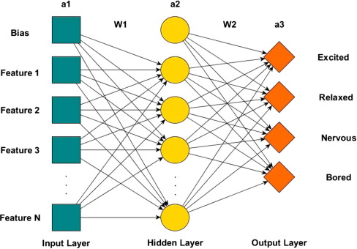
Model
10

Slide 11
Implementation code
import cv2
from model_loader import FacialExpressionModel
import numpy as np
rgb = cv2.VideoCapture(0)#WEB CAM 1
facec = cv2.CascadeClassifier('haarcascade_frontalface_default.xml')#XM FILE THAT DETECTS FACES IN WINDOW AND RETURN REGION
font = cv2.FONT_HERSHEY_TRIPLEX#TEXT FORMAT
def __get_data__():
_, img = rgb.read()
img = cv2.flip(img,1)#IMAGE FLIP
gray = cv2.cvtColor(img, cv2.COLOR_BGR2GRAY)
faces = facec.detectMultiScale(gray, 1.3, 5)
return faces, img, gray
MODEL TO START FUNCTION TO DETECT.

Slide 12
def start(cnn):
ix = 0#VARIABLE INC
while True:
ix += 1
faces, fr, gray_fr = __get_data__()
for (x, y, w, h) in faces:#REGION OF FACE
fc = gray_fr[y:y+h, x:x+w]
roi = cv2.resize(fc, (48, 48))#IMAGE RESIZE
pred = cnn.predict_emotion(roi[np.newaxis, :, :, np.newaxis])# CONVERTING ROI TO NUMPY ARRAY BECAUSE MODEL ACCEPTS IN NUMPY ARRAY FORMAT.
cv2.putText(fr, pred, (x, y), font, 1, (255, 255, 0), 2)#TEXT DISPLAY
cv2.rectangle(fr,(x,y),(x+w,y+h),(255,0,0),2)# RECTANGLE AREA THAT DISPLAY
if cv2.waitKey(5) == 27:#WAITING FOR KEY STROKE FOR 5MS AND ASCII VALUE OF ESC IS 27
rgb.release()
break
cv2.imshow('Filter', fr)
cv2.destroyAllWindows()
model = FacialExpressionModel("face_model.json", "face_model.h5")#ALREADY TRAINED MODEL TKES 5-6 HRS TO TRAIN MODEL
start(model)#PASSING

Slide 13
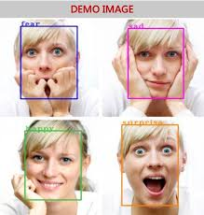
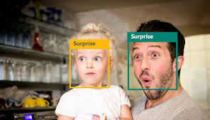
11

Slide 14
Our model detects 7 emotions like
Angry
Disgust
Fear
Happy
Sad
Surprise
Neutral.
12

Slide 15
Conclusion
Emotion recognition technology has come a long way in the last twenty years. Today, machines are able to automatically verify identity information for secure transactions, for surveillance and security tasks, and for access control to buildings etc.
To achieve this goal computers must be able to reliably identify nearby people in a manner that fits naturally within the pattern of normal human interactions. They must not require special interactions and must confirm to human intuitions about when recognition is likely.
13

